Slide 1
Generating Stable LTI CRN Networks and Calculating Their Transfer Functions
Joe Hellerstein
Nov 19, 2025

Slide 2
Research Direction and Requirements
Research direction: Use transfer functions to assess the impact of couplings between chemical reaction networks (CRNs)
Coupling types: sequential, parallel, branch, join, feedback
Requirements
Generate stable CRNs that can be modeled as a Linear Time-Invariant (LTI) system
Calculate the transfer function of generated CRNs

Slide 3
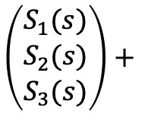



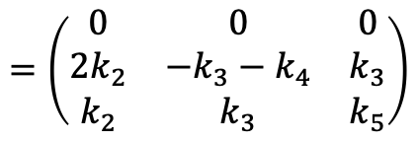



Sufficient Condition for a LTI CRN
Antimony model
ODE model
Laplace Transform
-> $S1 ;k1
S1 -> 2 S2 + S3 ;k2*S1
S2 -> S3 ;k3*S3
S2 -> ;k4*S2
S3 -> ;k5*S3
k1=1; k2=2; k3=3; k4=4
$$\dot{S_{1}}=0, { S}_{1}\left(0\right)=k_{1}$$
$$\left(\begin{matrix}{sS}_{1}(s) \\ sS_{2}(s) \\ sS_{3}(s)\end{matrix}\right)$$
$$=\left(\begin{matrix}0 & 0 & 0 \\ 2k_{2} & −k_{3}−k_{4} & k_{3} \\ k_{2} & k_{3} & k_{5}\end{matrix}\right)$$
$$\left(\begin{matrix}S_{1}(s) \\ S_{2}(s) \\ S_{3}(s)\end{matrix}\right)+$$
$$\left(\begin{matrix}k_{1} \\ 0 \\ 0\end{matrix}\right)$$
$$\dot{S_{2}}={2k}_{2}S_{1}−k_{3}S_{3}$$
$$\dot{S_{3}}=k_{2}S_{1}+k_{3}S_{2}−k_{5}S_{3}$$
{
$$A$$
Sufficient conditions for LTI CRN:
Zero or 1 reactant (unit stoichiometry)
Mass action kinetics
A matrix is the Jacobian.
A matrix is constant for an LTI system.

Slide 4
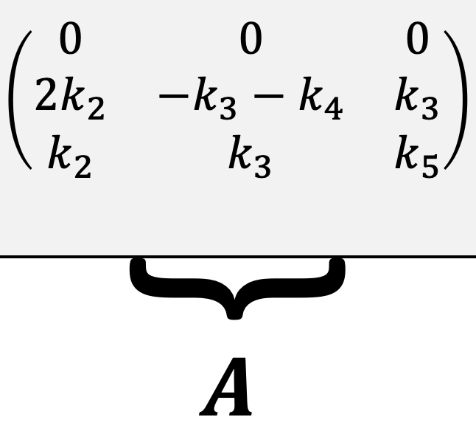
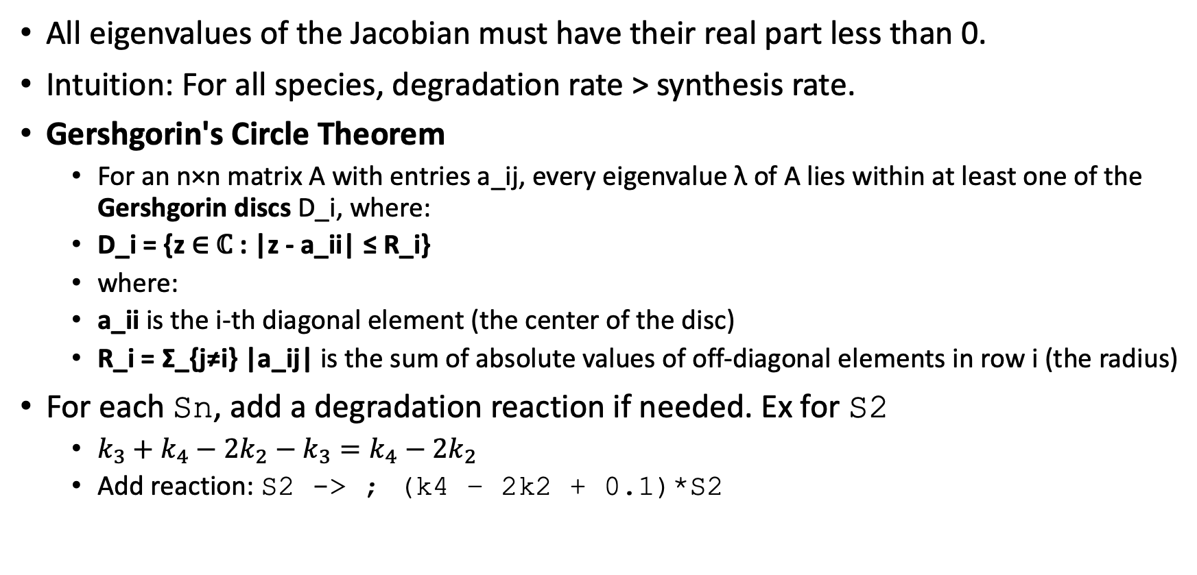
Ensuring Stability of a Generated CRN
All eigenvalues of the Jacobian must have their real part less than 0.
Intuition: For all species, degradation rate > synthesis rate.
Gershgorin's Circle Theorem
For an n×n matrix A with entries a_ij, every eigenvalue λ of A lies within at least one of the Gershgorin discs D_i, where:
D_i = {z ∈ ℂ : |z - a_ii| ≤ R_i}
where:
a_ii is the i-th diagonal element (the center of the disc)
R_i = Σ_{j≠i} |a_ij| is the sum of absolute values of off-diagonal elements in row i (the radius)
For each Sn, add a degradation reaction if needed. Ex for S2
$k_{3}+k_{4}−2k_{2}−k_{3}=k_{4}−2k_{2}$
Add reaction: S2 -> ; (k4 – 2k2 + 0.1)*S2

Slide 5
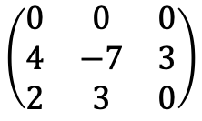
Symbolic Jacobian Matrix
To calculate transfer functions, we need the Jacobian with symbolic constants.
Tellurium/libsbml provide a numeric (numpy) Jacobian.
$$\left(\begin{matrix}0 & 0 & 0 \\ 4 & −7 & 3 \\ 2 & 3 & 0\end{matrix}\right)$$
Can obtain the symbolic Jacobian using a combination of Tellurium/libsbml and sympy.

Slide 6
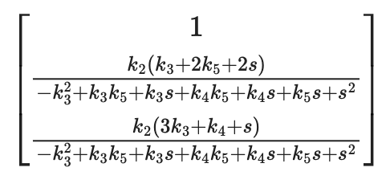
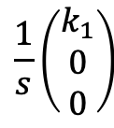




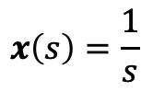
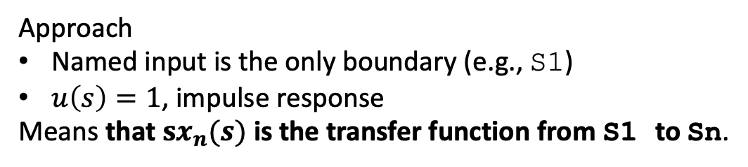
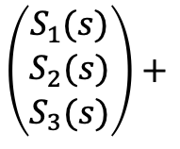
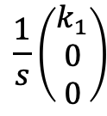

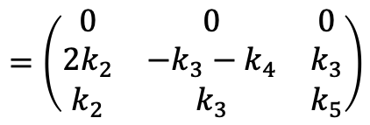
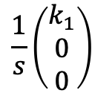
Calculating Transfer Functions
Laplace Transform
General expression for step response
$$\left(\begin{matrix}{sS}_{1}(s) \\ sS_{2}(s) \\ sS_{3}(s)\end{matrix}\right)$$
$$\frac{1}{s}\left(\begin{matrix}k_{1} \\ 0 \\ 0\end{matrix}\right)$$
$$=\left(\begin{matrix}0 & 0 & 0 \\ 2k_{2} & −k_{3}−k_{4} & k_{3} \\ k_{2} & k_{3} & k_{5}\end{matrix}\right)$$
$$\left(\begin{matrix}S_{1}(s) \\ S_{2}(s) \\ S_{3}(s)\end{matrix}\right)+$$
$$\frac{1}{s}\left(\begin{matrix}k_{1} \\ 0 \\ 0\end{matrix}\right)$$
$$sx(s)=Ax(s)+$$
Step response for example
$$\frac{1}{s}\left(\begin{matrix}k_{1} \\ 0 \\ 0\end{matrix}\right)$$
$$x\left(s\right)={\left(sI−A\right)}^{−1}$$
$$k_{1}$$
$x_{n}\left(s\right)$ is the Laplace Transform for species n.
$$x\left(s\right)=\frac{1}{s}$$
${G_{m,n}(s)=\frac{x_{n}(s)}{x_{m}(s)}}_{}$ is the Laplace Transform from $S_{m}$ t$o S_{n}$.
Approach
Named input is the only boundary (e.g., S1)
$u\left(s\right)=1$, impulse response
Means that $sx_{n}(s)$ is the transfer function from S1 to Sn.

